Slide 1
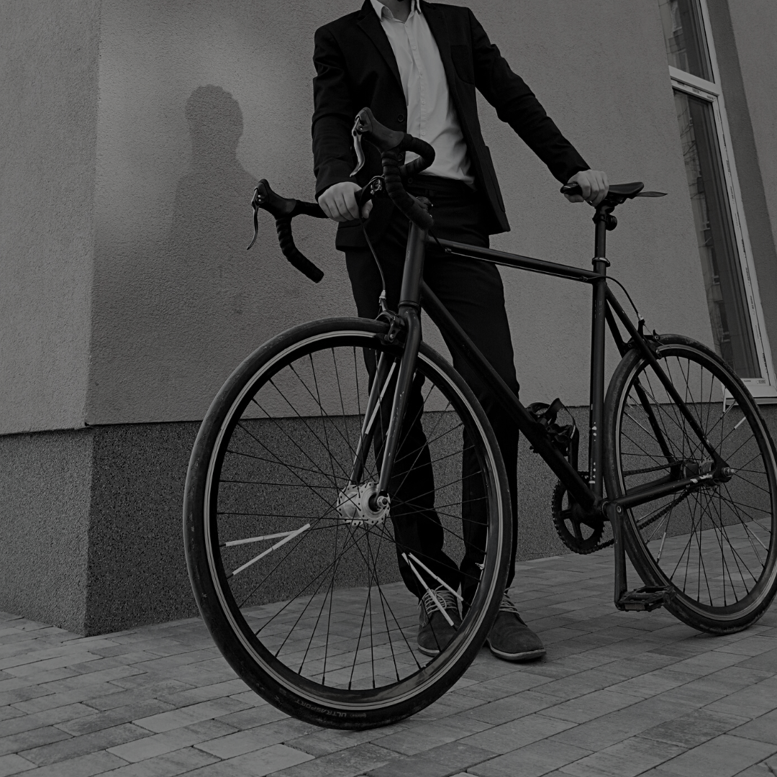
Autopilot for Advisors:
Creating a Self-Sustaining Practice So You Can Focus on You
Presented By:
Ed Blumenthal

Slide 2
August 19th, 2021

Slide 3
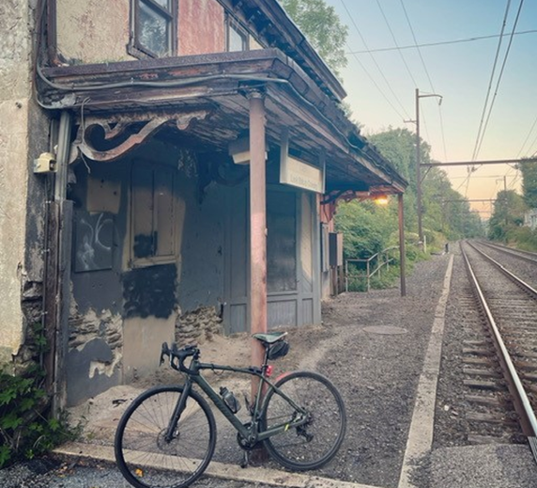
The Law The Stedmark Process Staying on Track

Slide 4
“Alpha”
A-G H-P P-Z Old ABCs… Now… “The Medal Ceremony”

Slide 5
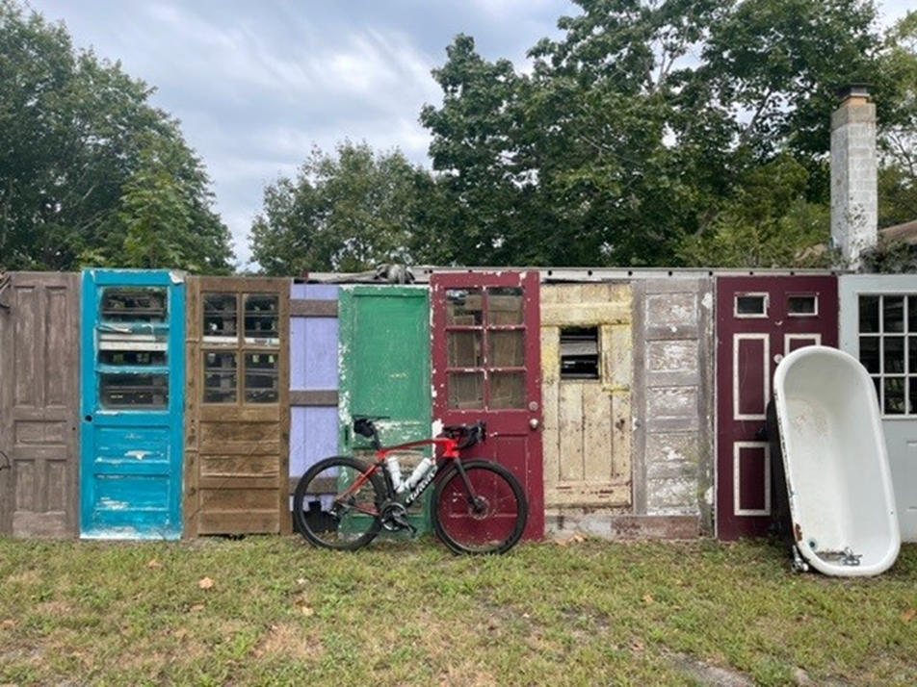
Recovery and return to the office

Slide 6
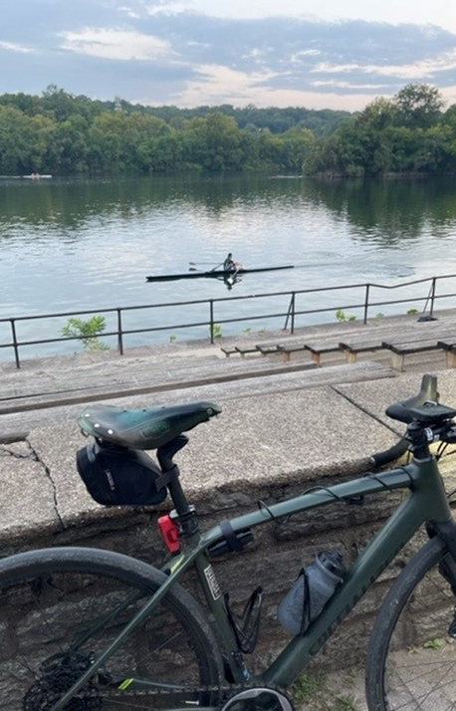
Team… A True Team
Training - Advisor, Staff, and Clients!
What do I spend my time doing?

Slide 7
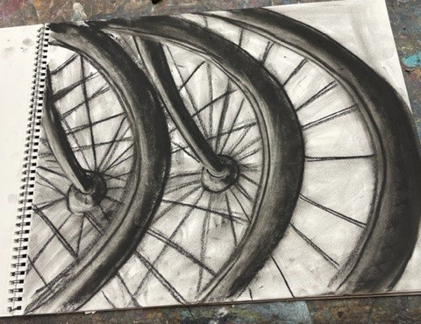
Safer hobbies…

Slide 8
ThankYouVeryMuch! Questions?

