Slide 1
How to Grow without Prospecting:
Connecting Your Way to Sales Success
Presented By:
Erik Strid

Slide 2
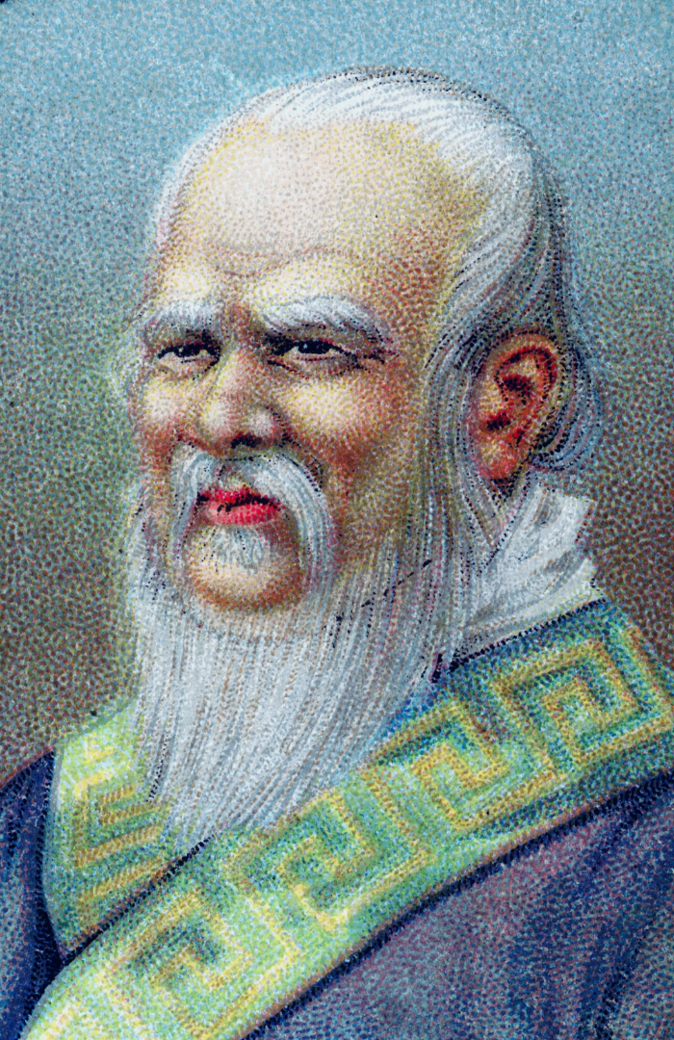
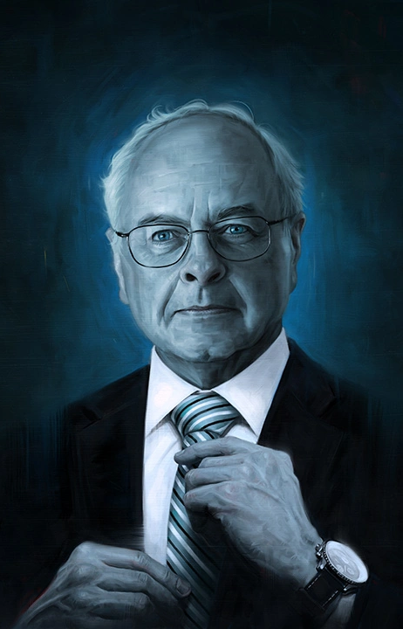
The nobility of our profession
“There is, I believe, no profession nobler than ours. When we do it well, we enrich the lives of people who may long outlive us, indeed perhaps people yet unborn. Believe in the nobility of what we do, believe in our limitless capacity to intervene decisively in people’s lives. Believe in your unique opportunity to do well – for yourself and the people you love – by doing good for others.”
Nick Murray
“Press on. It matters not how slowly you go. It matters only that you do not stop.”
Confucius
Notes:
*Click to show Confucius quote and hide nick Murray pic*

Slide 3
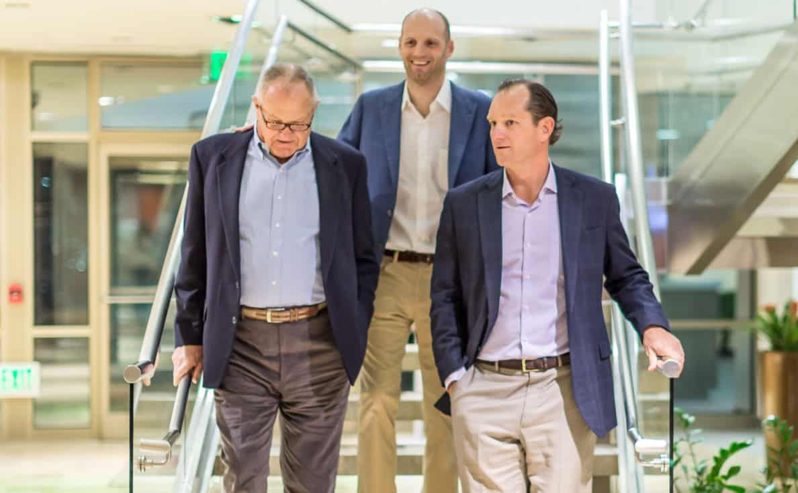

Slide 5
Messaging your Value

Slide 6
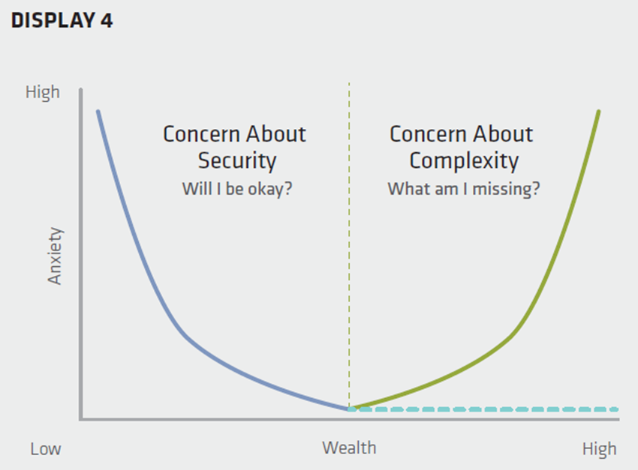
Messaging your Value
Source: Alliance Bernstein

Slide 7
Messaging your Value
Source: Alliance Bernstein

Slide 8
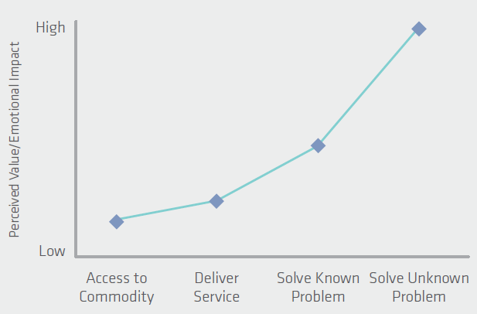
Messaging your Value
Source: Alliance Bernstein

Slide 9
Messaging your Value

Slide 10
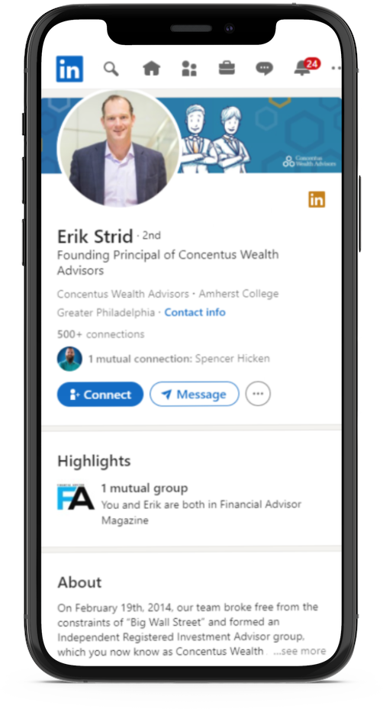
Lead Generation Strategies
Client Referrals
LinkedIn
COI Cultivation
PC Cultivation
Content Strategy

Slide 11
Lead Generation Strategies Client Referrals
Client Experience
Dedicated Client Experience Manager
Milestone Meetings
90 Day “No Contact”
Holiday/ Feel Good letters
Etiquette (Ice Cream)
Birthdays & Birthday Lunch
Annual Client Satisfaction call
Referral Script

Slide 12
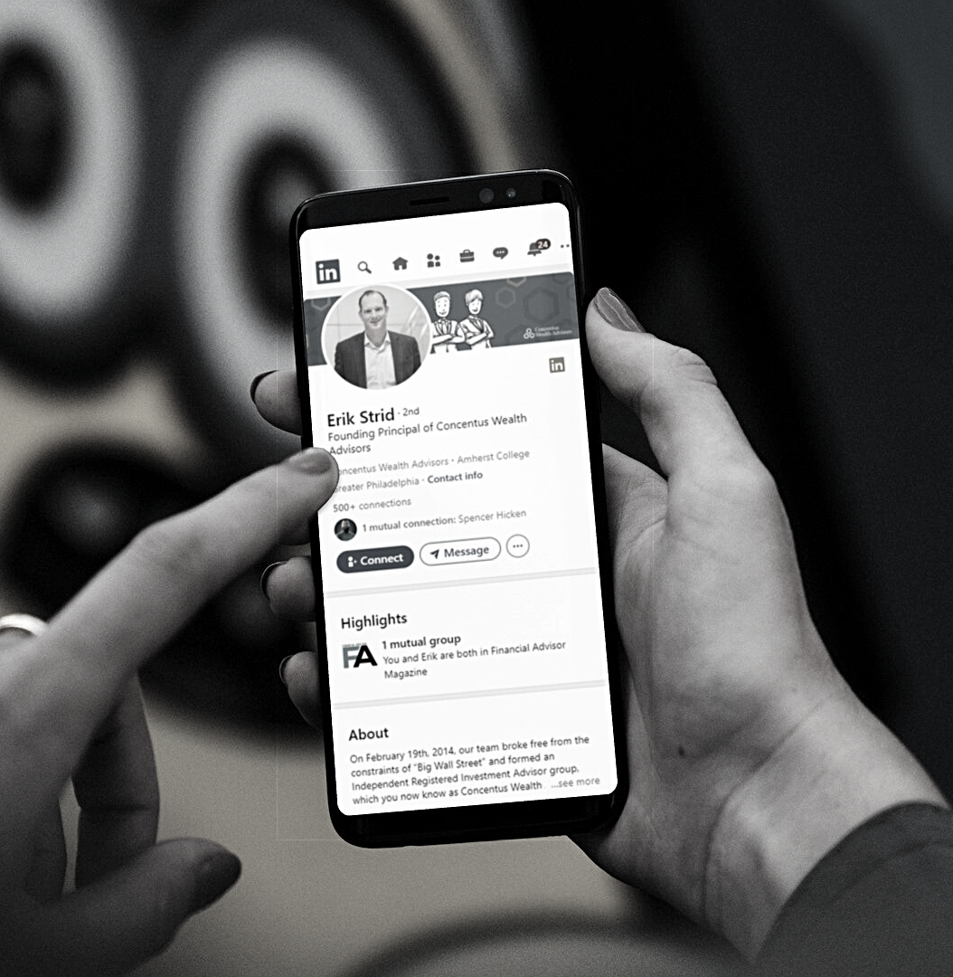
Lead Generation Strategies Linkedin
Job 1 is to establish a mutual connection and “Social Proof”
Invite all Personal Network
Invite select 2nd Connections to my connections
Invitation emphasizes our mutual connections
Invite to do an introductory Zoom
Invite to “Lunch with 4 Interesting People”
GET THEM IN THE POOL!

Slide 13
Lead Generation Strategies COI Cultivation
Most LinkedIn connections become a COI
Monthly Wilson Letters
Annual Courtesy Call
Invited to “Interesting People Network” events

Slide 14
Lead Generation Strategies PC Cultivation
Strategic Alliance partners
Always Identify all client Other Advisors
Annual CPA Content / Approach
Annual Attorney Content / Approach

Slide 15
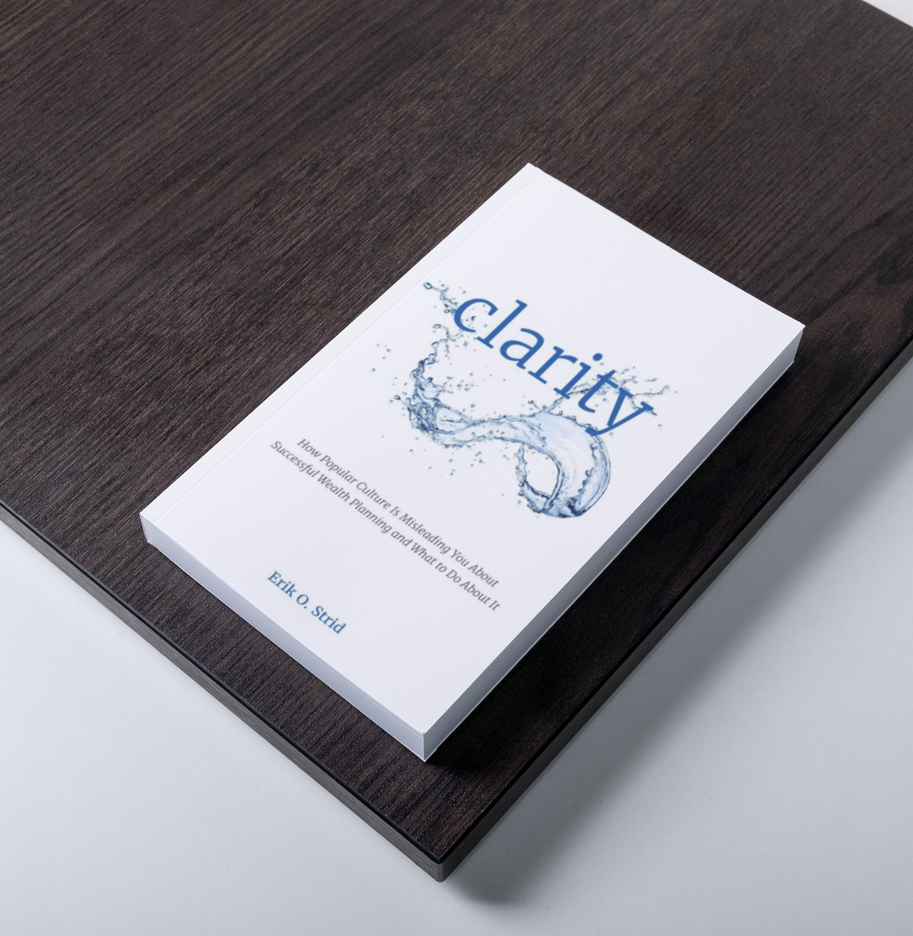
Lead Generation Strategies PC Cultivation
Author a Book!
Book Baby / 90 Minutes Books
Message Calendar
Monthly “Great Investors” series
Wilson Letters
Holiday / Feel Good
PC Drip
Social Media
Hopeless Optimist / Time Capsule of Wisdom
Family / Team posts

Slide 16
Lead Conversion
Right Fit Call
Private Briefing
The Riverkeeper Navigator
Onboarding Experience

Slide 17
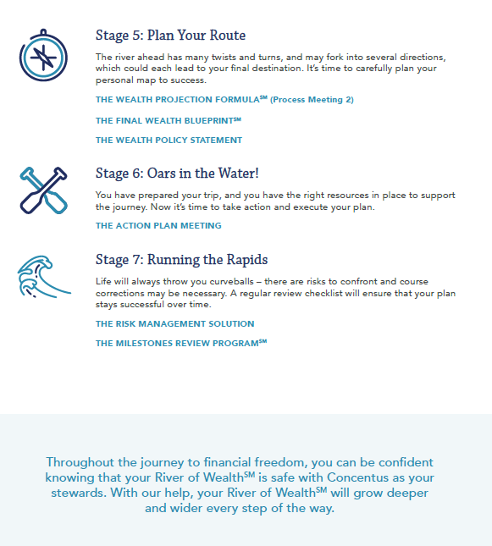

Slide 18
3803 West Chester Pike, Suite 225
Newtown Square, PA 19073
610-994-9190 | concentus.com

