Slide 1
Survival of the Fittest
The Secret to Making Your Processes More Efficient & Effective
Presented By:
John Halterman

Slide 2
DID YOU BUY INTO THE 3 BIG INDUSTRY LIES?
1. Salesman
2. Million
3. Big Metro

Slide 3
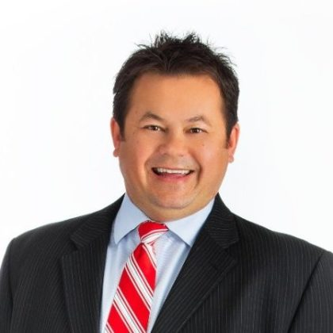
WHO WAS JOHN HALTERMAN?
Avg. Clients between $250-$750k
No outbound prospecting
Talented with a lot of potential
No Structure

Slide 4
Epiphany Moments
Notes:
Click to reveal speakers in order: Chad Henry
Ed Blumenthal
Rhonda Ferguson

Slide 5
LIFESTYLE
NO Weekends
2. NO Fridays
3. Sessions 3 Days a week
4. All Sessions in office or zoom
5. Sessions same time each day: 9:00, 10:30, 2:30
6. 2 Hour lunch breaks
7. Work 3 Weeks a month

Slide 6
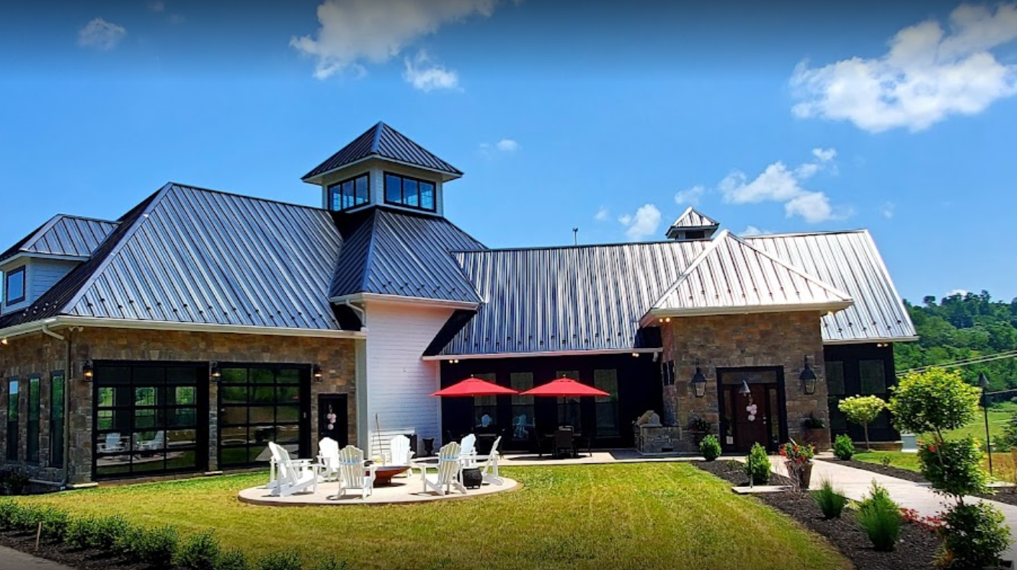
BRAND
Professional Practitioner with Swagger
Well Known
Run Practice like a surgeon
NO Service Calls
NO Prospecting Calls
NO Nurturing Calls

Slide 7
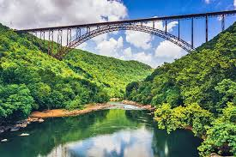
WEST VIRGINA
Bridgeport, WV Population 9,000
Harrison County, WV 67,000
Fortune 500 Domiciled 0
Avg Household Income $48,000 (49th)
WV Economy 50th
WV Overall Education 50th
WV Drug Use 4th
WV Deaths per capita drugs 1st

Slide 8
IDEAL CLIENTS FOR WV
Individuals in the Retirement Redzone
(ages 50-80)
2. Middle Class Millionaires

Slide 9
Passions
Notes:
Click to reveal passions in order: Coaching
Entertaining
Adventuring

Slide 10
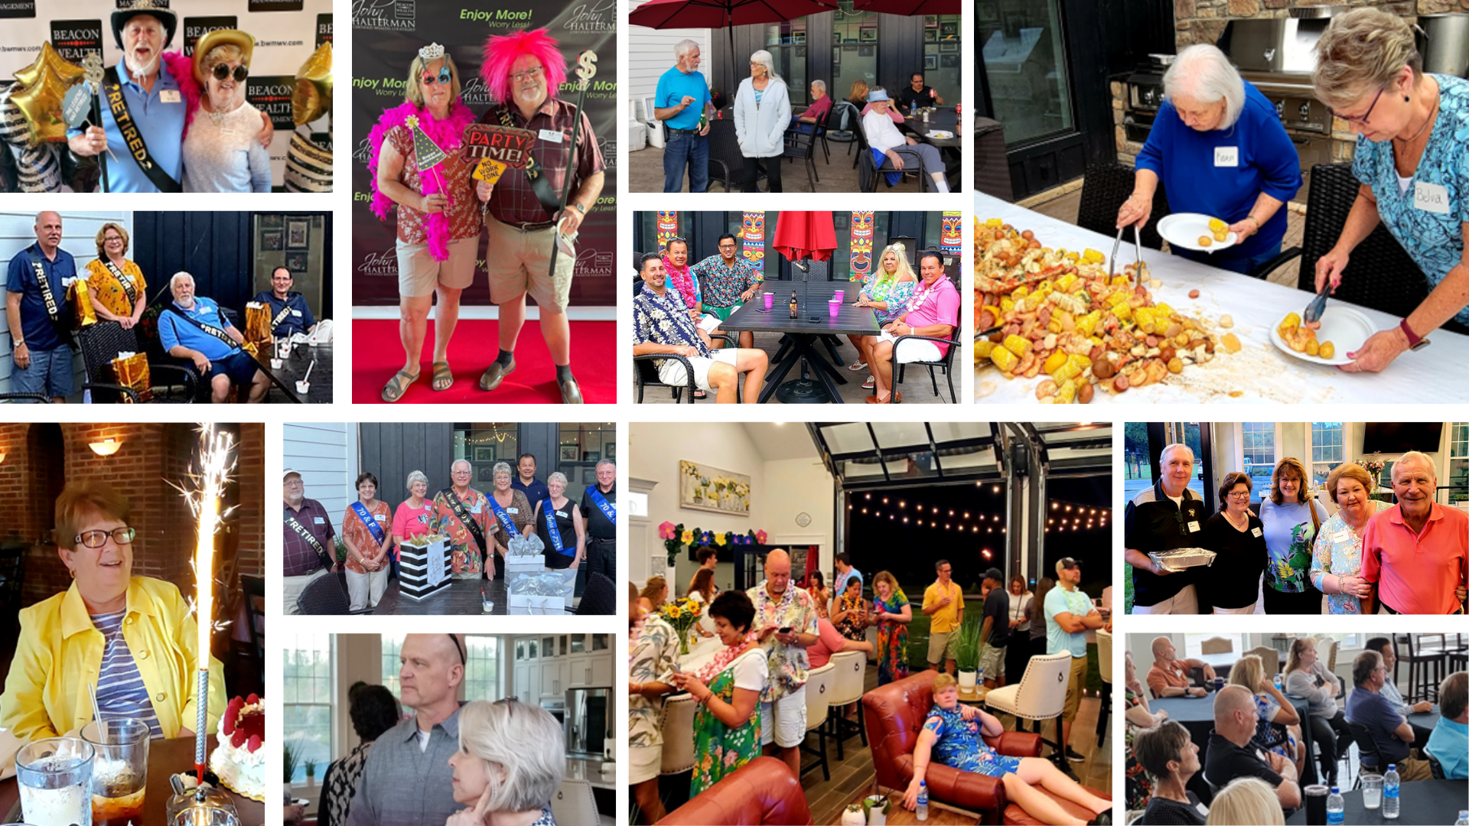
Celebrity expert edutainer
Notes:
*CLICK TO SHOW PICTURES WITHOUT OVERLAY*

Slide 11
BOURBON & BBQ
LUAU
SOCIAL EVENTS
MILESTONE CELEBRATIONS
THEMED APPRECIATION EVENTS
EDUCATIONAL EVENTS
Notes:
*CLICK TO REVEAL LABELS FOR EVENTS*

Slide 12
client experience ? As a privately owned wealth management firm, we understand that will never outbrand the trillion-dollar wall street marketing machines. We feel confident we provide a much more exclusive client experience
Uniquely Personalized, Comprehensive Wealth Strategy
Investment Portfolio with Active Downside Risk Management designed for
Individuals in the Retirement Redzone
Personal Wealth Portal (Organization and Coordination or all Wealth)
1 Page Asset Summary
Highly Engaging Relationship
As Needed: Strategy Update and Progress Sessions
Weekly: Wisdom 2 Wealth Insights and Special Reports
Monthly: Wisdom 2 Wealth Educational Event Invites
Summer Extravaganza and Fall Festival Celebration Invites
Semi-Annual: Elevate and Progress Calls
Occasionally: Social Event Invites

Slide 13
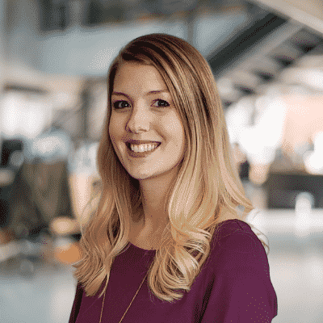
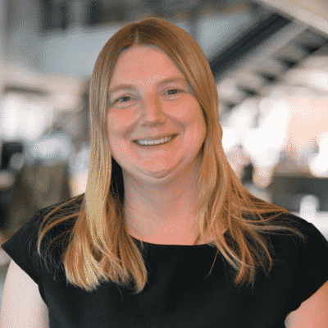
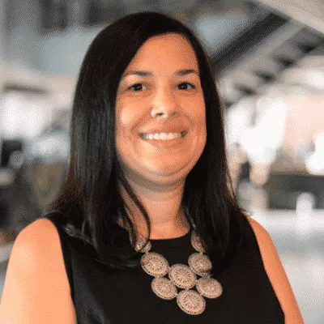
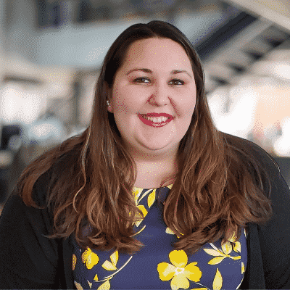
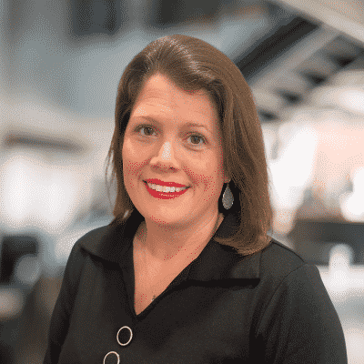
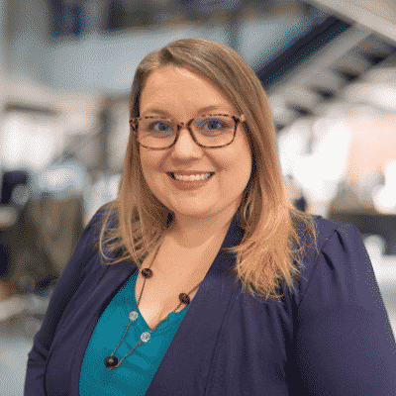
TEAMWORK MAKES THE DREAMWORK
Associate Service Advisor
Community Development Coordinator
Client Concierge

Slide 14
KEY PERFORMANCE INDICATORS (KPI’s)
$2 Million a Week of New AUM
Notes:
Click to reveal $2Million a week of New AUM

Slide 15
Let’s do the Math
NEW AUM
AVG CLIENT
NUMBER OF NEW CLIENTS
CONVERSATION RATIO PROSPECT TO CLIENT
CONVERSION RATIO OF NEW PROSPECTS TO SESSIONS
# OF SESSION PER WEEK
# NEW PROSPECTS A MONTH
# of COMMUNITY DEVELOPMENT CAMPAIGNS

Slide 16
MARKETING STRATEGY
Lead Generation (community development)
Engage and Expand Relationships
Expert Credibility
Branding

Slide 17
Simplify
Processes,
Processes,
Processes!!!

