Slide 1
The Four Phases
X
THE Way of Powering
Past Plateaus
Presented By:
Matt Hicken & Tony Parmenter

Slide 2
Goody bag
16 Steps of a Master Sales Presentation
The Sales Pipeline
The 5 Critical Aspects of Effective Daily Planning

Slide 3
The Four Phases
Solid Foundations
Strengthening the Business
Pipeline Production
Thrive

Slide 4
Notes:
Foundations is really all about maximizing your time.
We break that down into four parts: Time Ownership, Automation, Team Foundations, and Organizing Client Communications

Slide 5
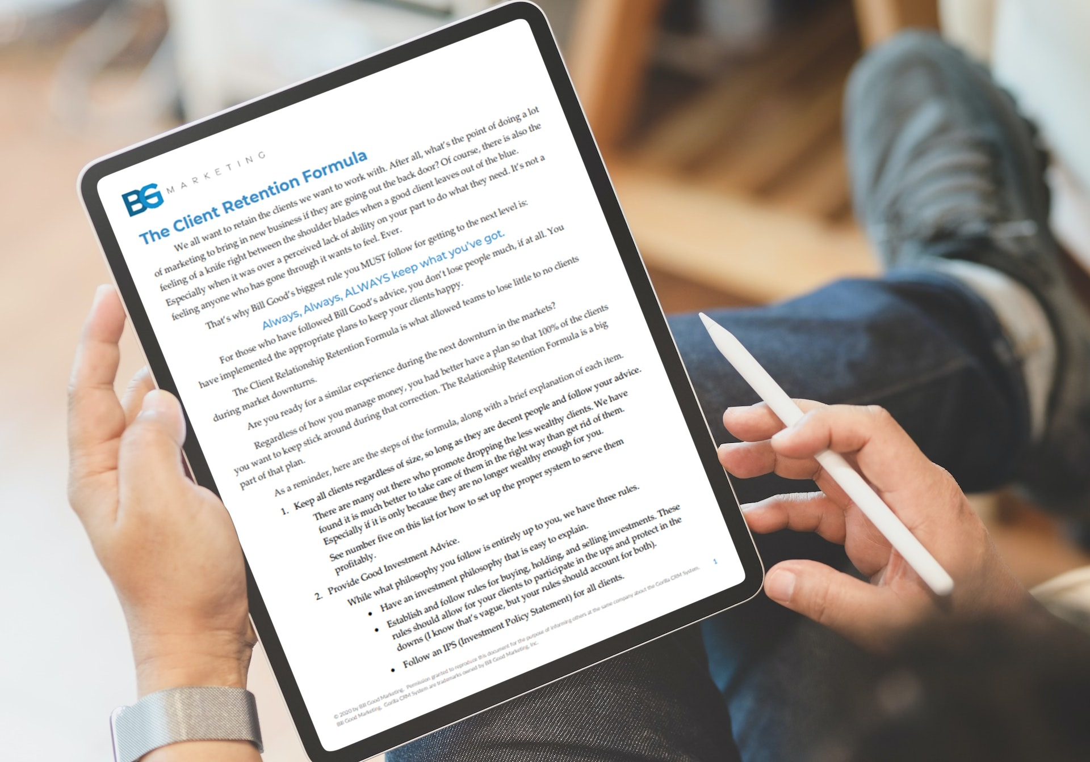
Keep Everyone, Unless…
Birthdays
Tier Based on Time
Personal Contacts
Productive Reviews
Educate
Etiquette
Education and Appreciation Events

Slide 6
Strengthen the business
Notes:
Strengthening the Business is all about Engagement. Engaging your team, Engaging your Clients and Engaging your Network

Slide 7
Engaged Team Members Need…
Catch the Vision
Clear Expectations
Proper Training
Resources
Motivational Compensation

Slide 8
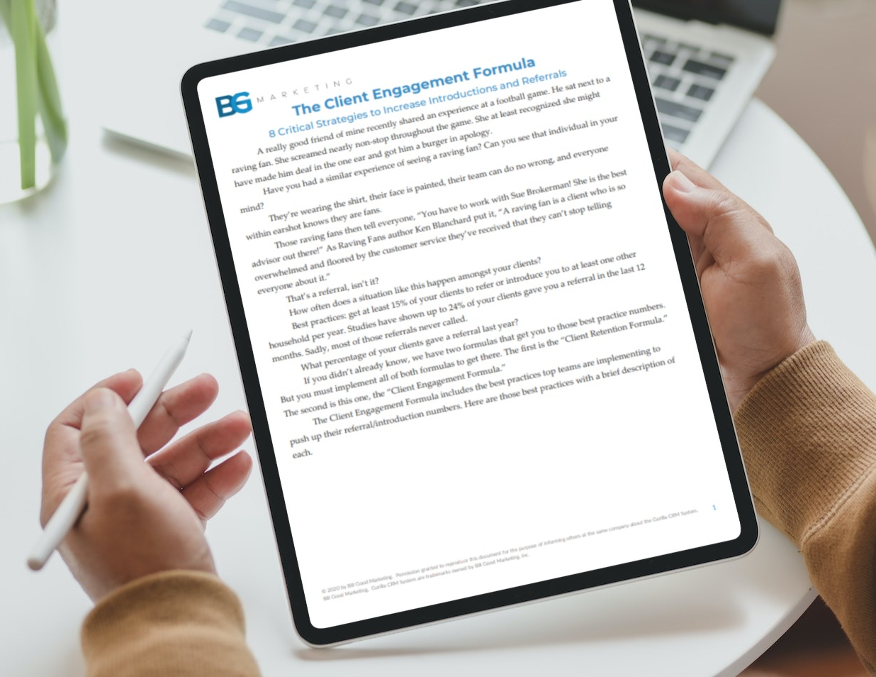
Family Financial Advisor
Tangibles
Beyond Expected Etiquette
Participatory Events
Advocate for Clients
Profiles
Celebrate Milestones
Solicit Input

Slide 9
Pipeline production
Notes:
You need 4 producing pipelines at all times. Giving examples of why one isn’t enough.

Slide 10
The most bang for your buck (In order of ROI)
Client Introductions
Client Referrals
Strategic Partners
Existing Prospects
Connections
Seminars
Webinars
Direct Mail
Cold Calling
TIPPing
Digital

Slide 11
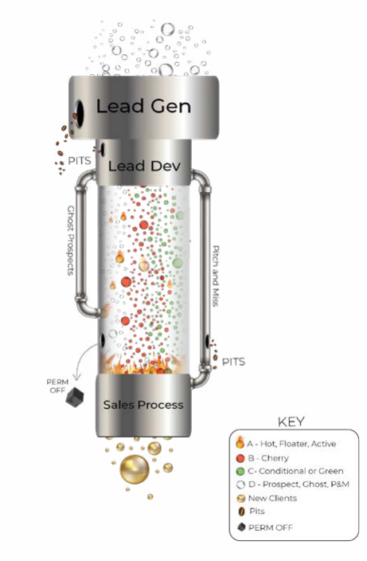
The sales pipeline

Slide 12
Thrive
Notes:
Thrive is about setting your business up to run itself. It starts with planning and ends in branding.

Slide 13
Goody bag
16 Steps of a Master Sales Presentation
The Sales Pipeline
The 5 Critical Aspects of Effective Daily Planning
bgmtips.com/plateaus

