Slide 1
The More-Better Model Day:
Leveraging Technology to Save Time and Effort
Presented By:
Frantz Widmaier

Slide 2
What are we talking about?
Warm Welcome, Loom, BombBomb
Canva
Calendly/Zoom
Grammarly & Hemingway Editor
Google Business & Quick ads
SEO & Email Automation

Slide 3
Video messaging

Slide 4
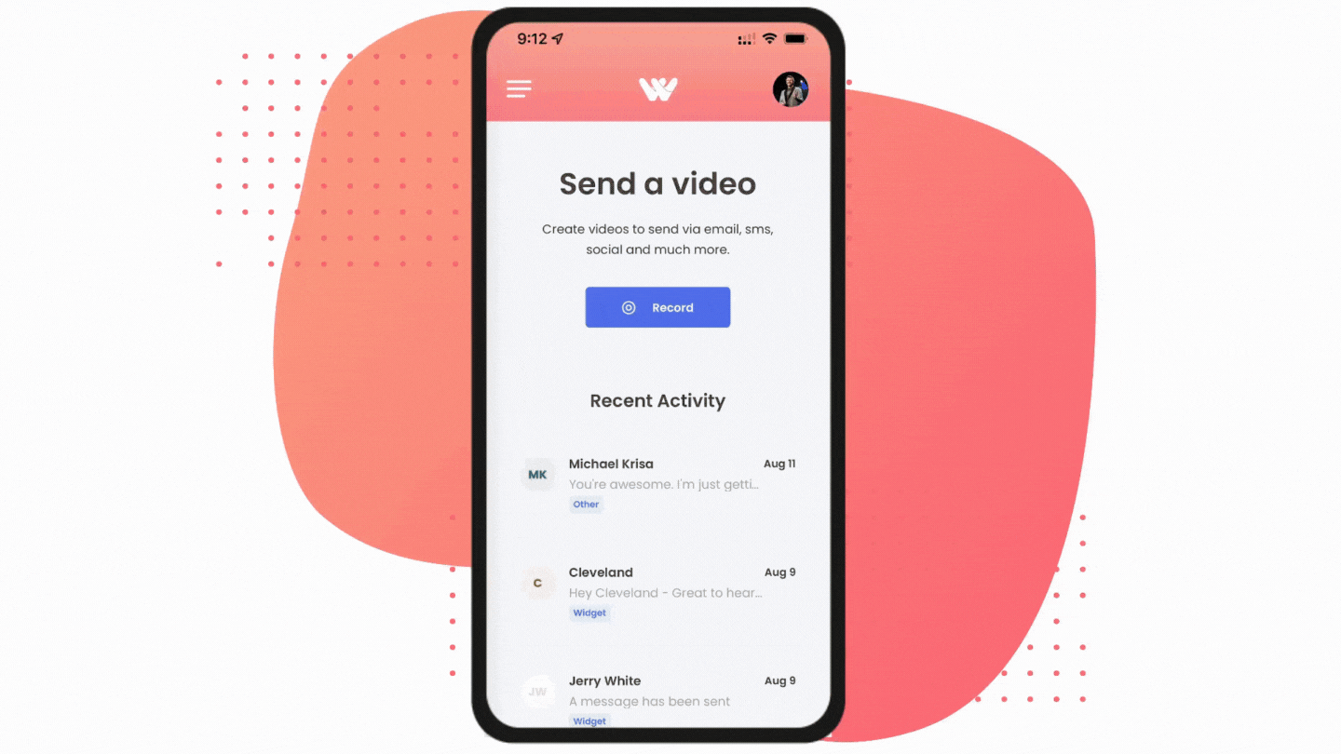
Video messaging
$8-$24 /mo
Use Cases
Prospecting Emails
Client Emails
One-on-One Emails
Social Media Video
Birthday Videos
Milestone Events
Website Visits

Slide 6
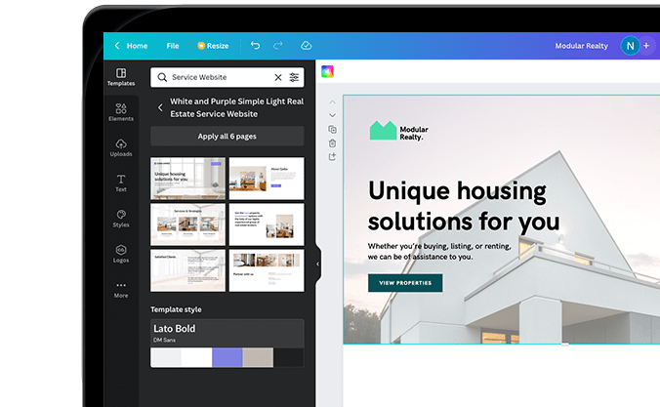
Design
Free / $149 per year
Use Cases
Social Media Posts
Business Cards
Logos
Invitations
Presentations
Reports
Videos
Newsletters
Brochures

Slide 8
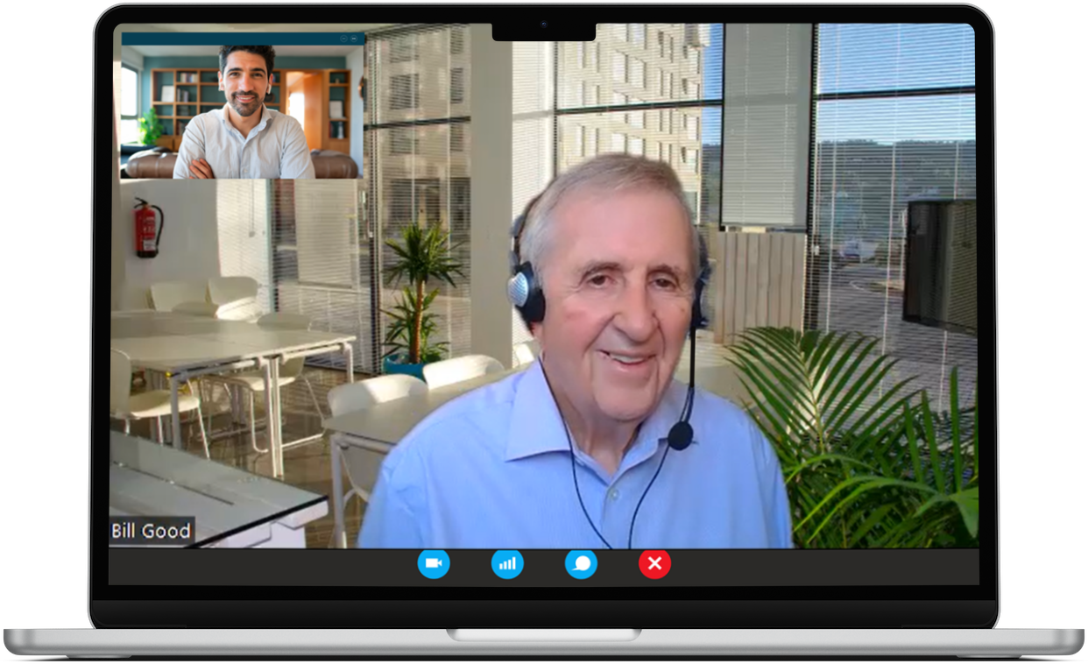
Scheduling
Automate Scheduling and Face-2-Face
Meeting Types
Routing Logic
Follow-Up Messaging
Auto Update Calendar
Auto Issue Meeting Link
Easy Integration
Free- $12 Per month | Zoom $15+

Slide 10
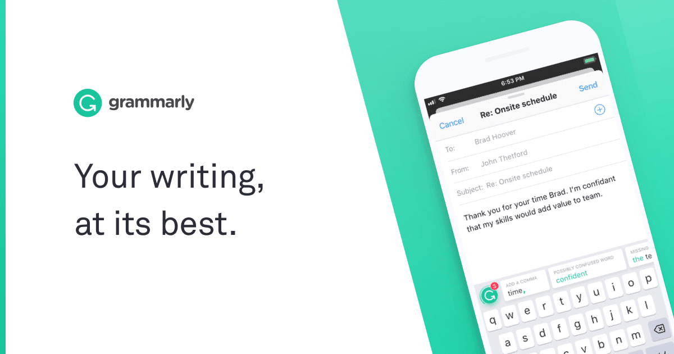
Clearer Communication
Use Cases
Improve Clarity
Maintain Legibility
Catch Mistakes
Manage & Improve Style
Email Plugins
Free / $15+ /mo

Slide 11
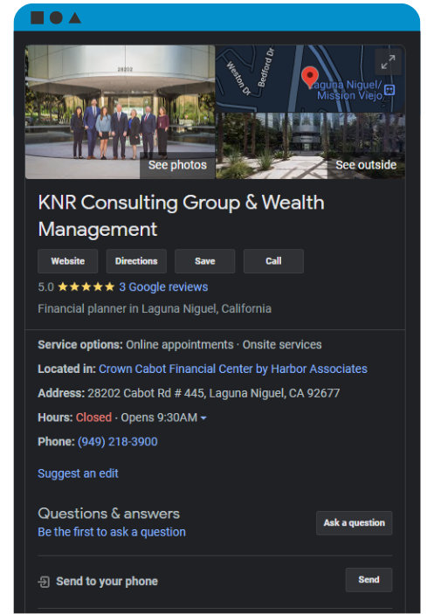
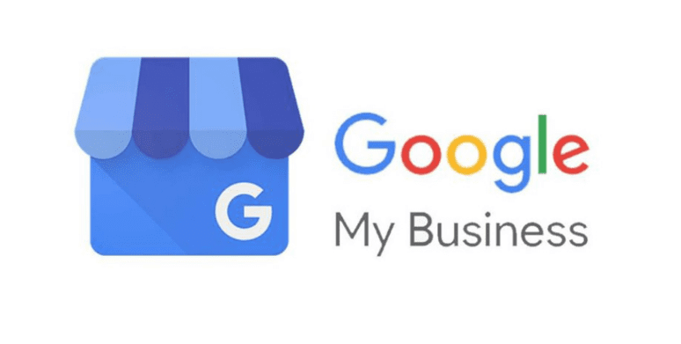
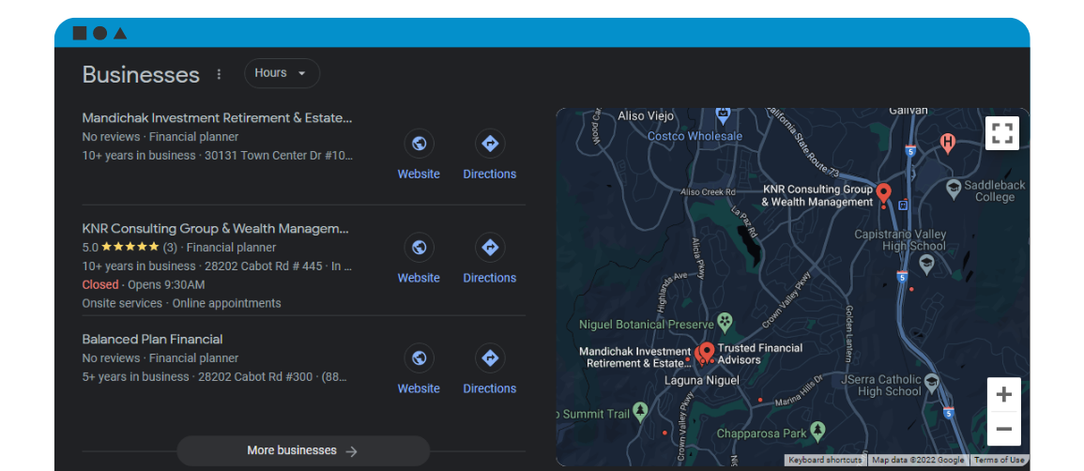

Slide 12
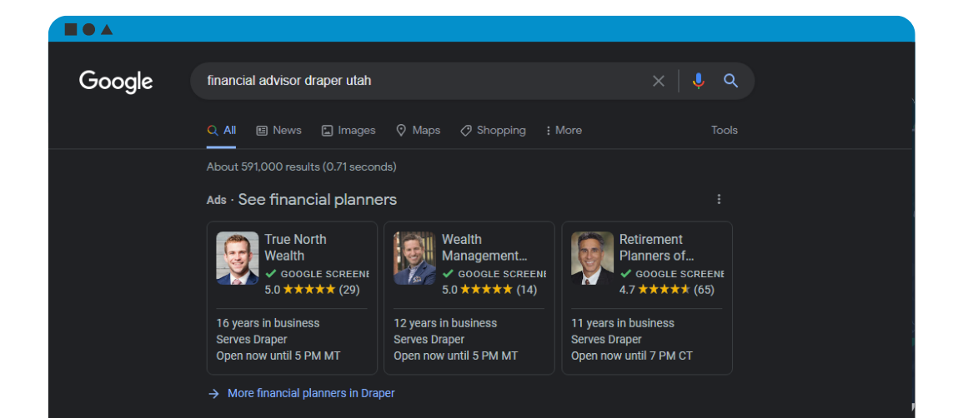

Slide 14
SEO & digital Advertising
$500 /mo
SEO is more effective for local businesses and gives longer term returns.
Awareness
Branding
Credibility & Trust
ROI
Cost
Sustainability

Slide 15
SEO & digital Advertising
$50 – 2500+ /mo
PPC (Pay-Per-Click) can give faster results and focuses heavily on very targeted search keywords.
Positioning on Page
More Control
Speed
Agility
A/B Testing
Potential for Faster Conversion

Slide 16
Email Marketing Automation
$350 /mo
Consistent on Brand Communication
One-on-One Messaging vs Advertisements
Timely Messaging
Insight Into Interests

